Slide 1
Fossils and The Fossil Record

Slide 2
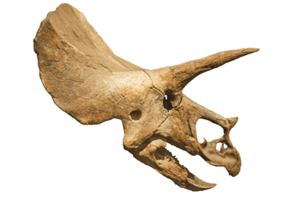
By the end of this lesson, you should be able to:
• | Describe what a fossil is and how it is formed.
• | Describe the different types of fossils.
• | Explain the fossil record and how it provides evidence for evolution.

Slide 3
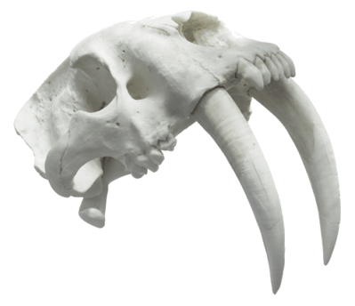
Evolution is very difficult to observe during our lifetime because it takes a very long time!
Because of this, fossils provide us with good evidence for evolution as they show us organisms from the past millions of years.
Looking at the similarities and differences between fossils over time can help us to piece together the evolution of different species.

Slide 4
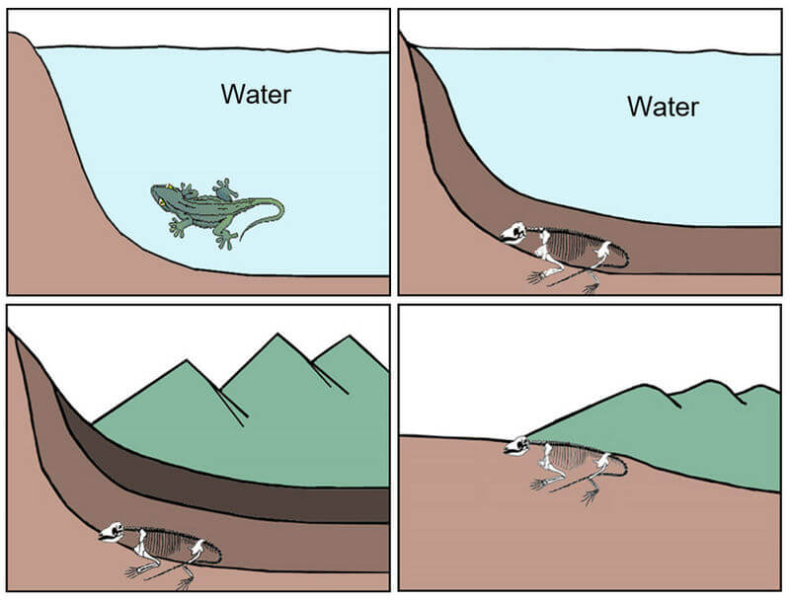
The conditions needed to preserve a fossil are difficult to achieve.
First the evidence must not be eaten or destroyed, and then it must decay slowly.
Because of this, fossilisation is more likely to occur when animals are buried quickly by sediment.

Slide 5
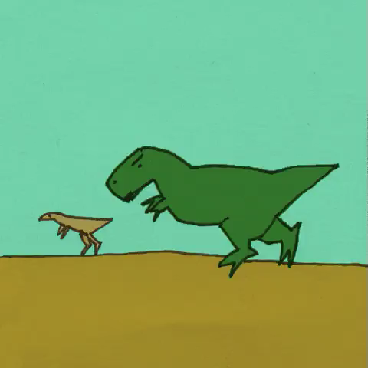
Sediment is sand, dirt or organic material that gets layered on top of biological remains over thousands or millions of years.
The sediment is compressed to form sedimentary rock. After the remains have been preserved, the sediment is often eroded and weathered away over time through wind, rain or ice. This exposes the fossil evidence for us to then discover!

Slide 6
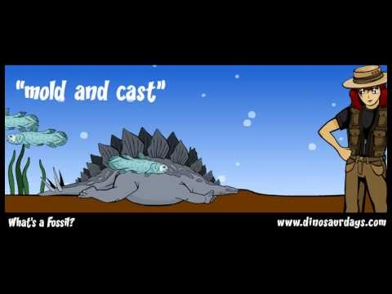

Slide 7
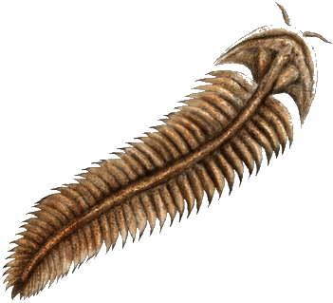
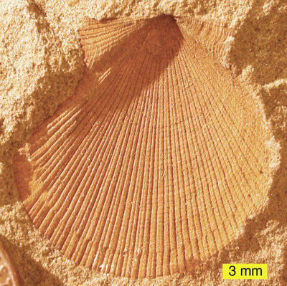
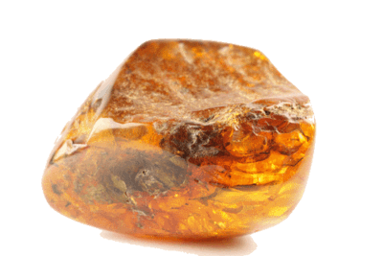
Different types of fossils can tell us how organisms looked and moved, what they ate, how they reproduced and how they lived.
These fossils are known as: body fossils, trace fossils (mould and cast fossils) and chemofossils.

Slide 8
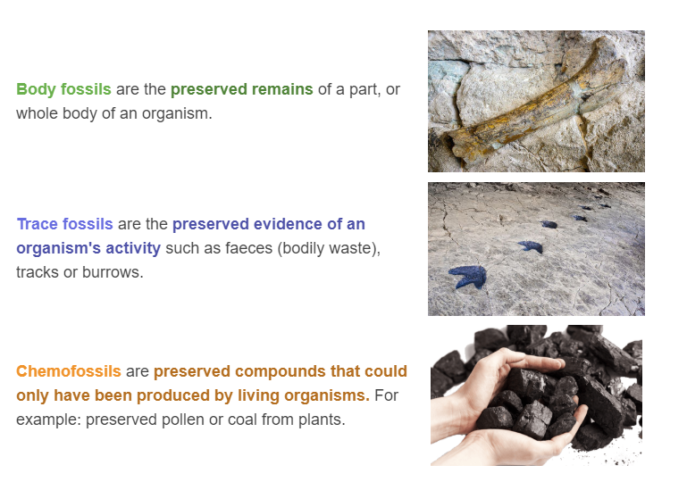
Fossils are identified based on what they contain.

Slide 9
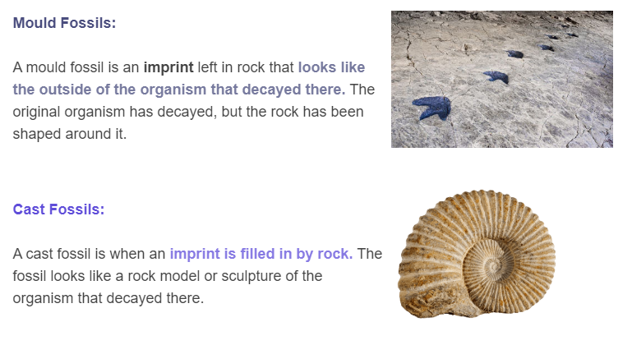
Mould and cast fossils contain no original evidence, but instead take the shape of the evidence that was once buried in rock.

Slide 10
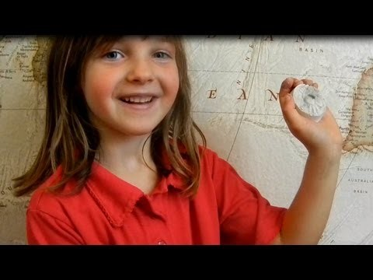

Slide 11
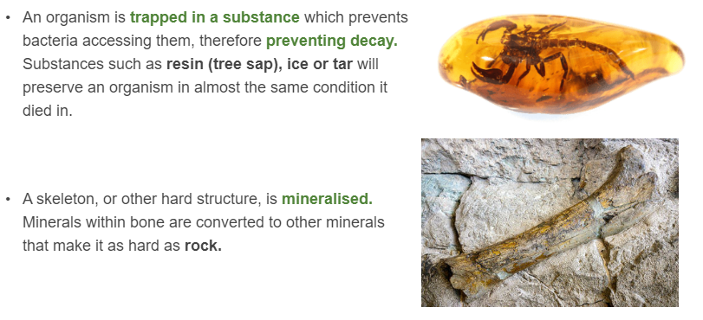
Body fossils can occur in different ways:

Slide 12
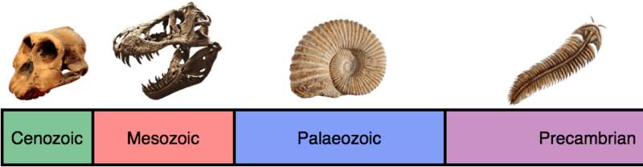
Once a fossil has been preserved and then discovered, it can be inspected by scientists to find out more about the organism it belonged to, even how old it is!

Slide 13

How? Through dating, of course!
...not quite. In this context, we're talking about fossil dating.
There are two methods of fossil dating:
1. Absolute dating
and
2. Relative dating

Slide 14
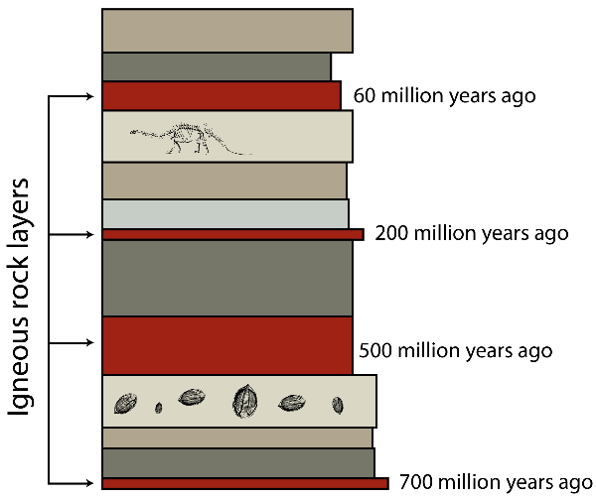
Absolute dating is the process of determining how old the rock is by looking at the radioactive material in the rocks and how it has decayed.
Relative dating is the term used to describe how we know that deeper layers are older and layers closer to the surface are younger.

Slide 15
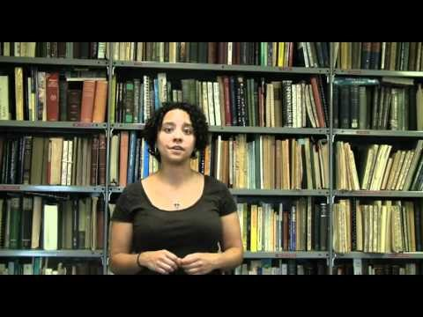

Slide 16
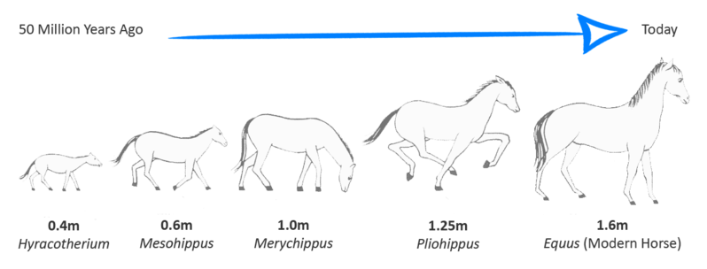
The image below is an example of a fossil record.
It shows us how the evolution of the horse has been occurring for over 52 million years!

Slide 17
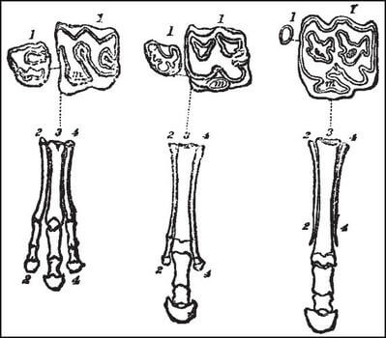
This shows how time and new conditions can encourage evolution to occur, and form new species.
The horse's fossil record shows that the modern horse, approximately 1.6m tall and with single-toed feet, has evolved over 52 million years from a 40cm tall horse-like animal with three-toed front feet and five-toed back feet!

Slide 18
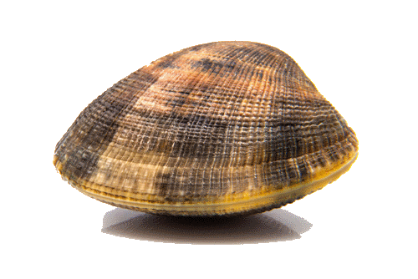
Fossils form in sedimentary rock.
An organism has a better chance of being fossilised if it lives under water as it will be preserved under sediment in the sea (or lake/river bed).
With all this information in mind, it could be concluded that marine animals with hard shells or skeletons (parts that are slow to decay) would have more complete fossil records.

Slide 19
Soft organisms such as mosses or slugs will be less likely to be fossilised, and therefore have a less complete fossil record.
This is because they lack the hard structures like shells or bones that dinosaurs, molluscs and humans have.
Due to this lack of hard structures, the organisms are quick to decay, often decaying before fossilisation can begin.

Slide 20
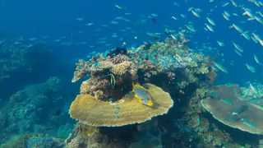
The fossil record shows that the number, and type of species on Earth do not remain the same over time and are increasing, despite extinction events.
This is consistent with what Darwin observed about evolution: that new species can be produced from a common ancestor, and species are not predetermined.

Slide 21
